Slide 1
Diversity, Equity, and Inclusion
Unconscious Bias
Odinakachukwu Ehie, MD
Clinical Associate Professor
Pediatric Anesthesia
Department of Anesthesiology
LaMisha Hill, PhD
Licensed Psychologist
Adjunct Professor, OB/GYN
Office of Diversity and Outreach

Slide 2



Creative Commons License
Attribution-NonCommercial-Share Alike 3.0 Unported
You are free:
to Share — to copy, distribute and transmit the work
to Remix — to adapt the work
Under the following conditions:
Attribution. You must give the original authors credit (but not in any way that suggests that they endorse you or your use of the work).
Noncommercial. You may not use this work for commercial purposes.
Share Alike. If you alter, transform, or build upon this work, you may distribute the resulting work only under a license identical to this one.
See http://creativecommons.org/licenses/by-nc-sa/3.0/ for full license.

Slide 3
Objectives
Explain two key differences between bias and unconscious bias by providing at least one example of each.
Assess one’s own unconscious biases in relation to the workshop exercises in a small group discussion.
Explain two reasons for reducing bias in a safe and nonthreatening space.
Identify three ways to apply concepts around unconscious bias to be intentional in the clinical environment.
Model three ways to successfully interact with socially dissimilar colleagues and patients.

Slide 4
Panic Zone
Stretch Zone
Comfort Zone

Slide 5
House Rules for the Interactive Session
Please have your videos on throughout the session
Assume positive intent
Listen actively
Participate fully and brave leaving your comfort zone, if possible
Step Up, Step Back
Share your story using “I” statements
Confidentiality
Other suggestions?

Slide 6
Introduction in Small group setting
Name one thing you are hoping to get from this workshop
Name
Pronoun
Your Department

Slide 7
Whom To Leave Behind Exercise
Notes:
The Whom to Leave Behind activity asks the group to finalize a list 8 people out of 12 candidates to put on a spaceship to another planet, as the Earth is doomed for destruction. This activity forces the participants to reason through their selection of the passengers, revealing participant biases and assumptions made on the passengers’ short descriptions.

Slide 8
Harvard Implicit Association Test
https://implicit.harvard.edu/implicit/takeatest.html
Notes:
https://implicit.harvard.edu/implicit/takeatest.html
The Harvard Implicit Association Test (IAT) further increases the test-takers’ self-awareness of their implicit biases. The discussion space built into our workshop allows them to process their immediate feelings in a safe manner and explore the relationship of their findings to instances of bias they’ve witnessed in their educational training and workplace. Facilitators also push for reflection on further reflection on how implicit biases and structural racism has manifested in their education and training. Having taken the Black-White Implicit Association Test as part of medical school was found to be a statistically significant predictor of decreased implicit racial bias in medical students from their first to last semester.¹⁷ The IAT has also been demonstrated to be a much better predictor of discrimination towards a racial group than self-reported attitudes, and has been a consistent predictor of a wider range of judgments, behaviors, and choices.

Slide 9
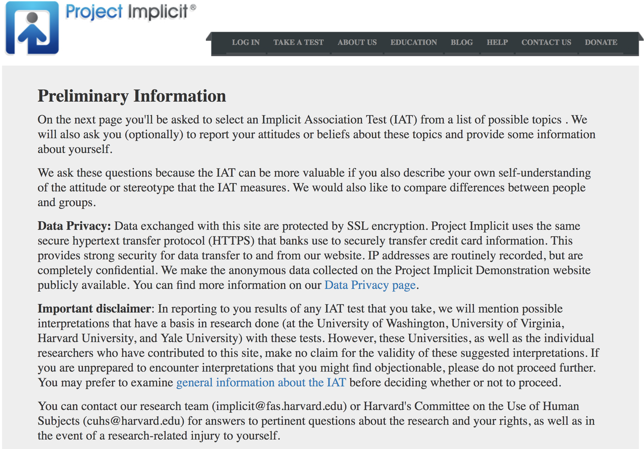

Harvard Implicit Association Test

Slide 10
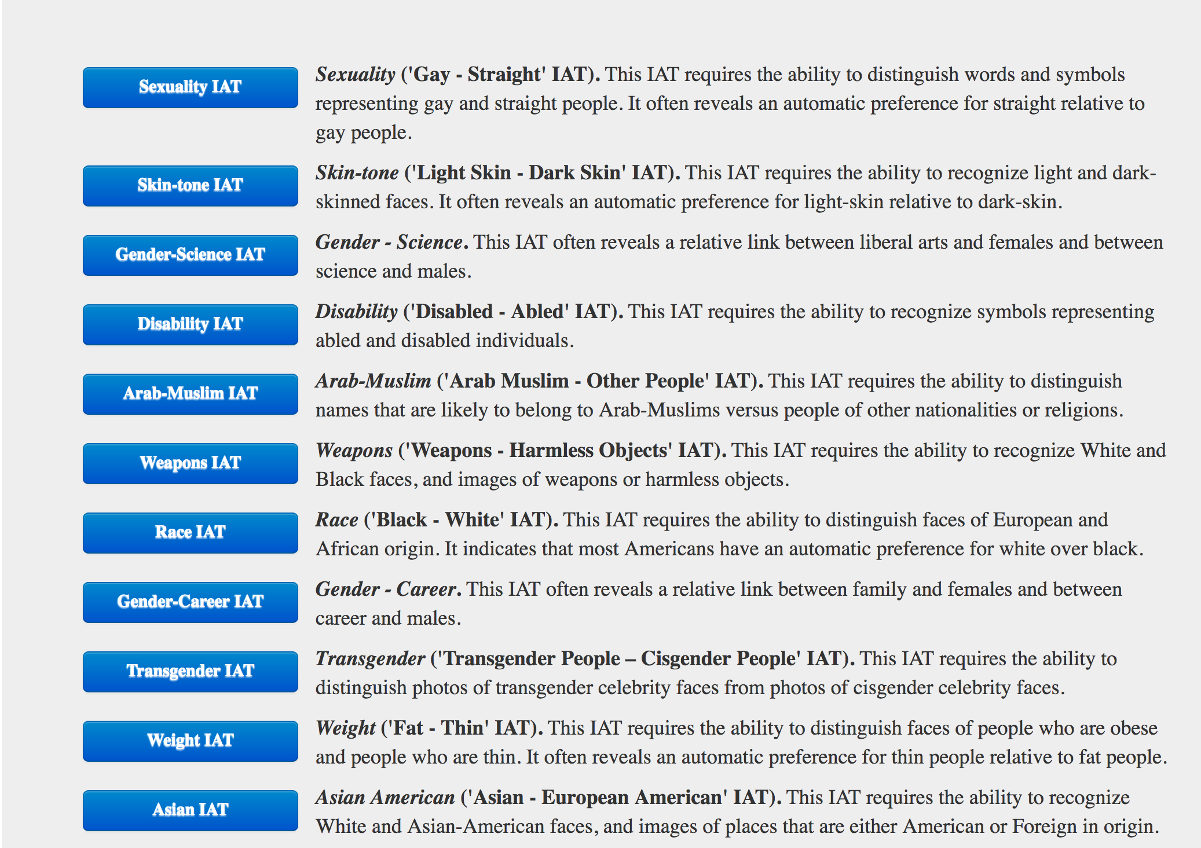
Harvard Implicit Association Test

Slide 11
Harvard Implicit Association Test
https://implicit.harvard.edu/implicit/takeatest.html
Notes:
https://implicit.harvard.edu/implicit/takeatest.html
The Harvard Implicit Association Test (IAT) further increases the test-takers’ self-awareness of their implicit biases. The discussion space built into our workshop allows them to process their immediate feelings in a safe manner and explore the relationship of their findings to instances of bias they’ve witnessed in their educational training and workplace. Facilitators also push for reflection on further reflection on how implicit biases and structural racism has manifested in their education and training. Having taken the Black-White Implicit Association Test as part of medical school was found to be a statistically significant predictor of decreased implicit racial bias in medical students from their first to last semester.¹⁷ The IAT has also been demonstrated to be a much better predictor of discrimination towards a racial group than self-reported attitudes, and has been a consistent predictor of a wider range of judgments, behaviors, and choices.

Slide 12
Harvard Implicit Association Test
What surprised you about your results?
What feelings did you notice bubbling up?
How does unconscious bias manifest in your educational training? In your workplace?
How does structural racism manifest in your educational training? In your workplace?

Slide 13
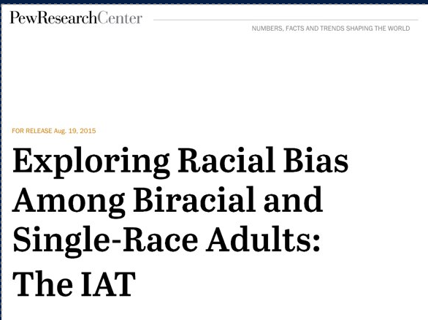
Racial Preferences of White/Black/Biracial Adults
Pew Research Center used IAT to measure racial bias
  Single-race whites, blacks, Asians
  Biracial (white and black) or (white and Asian)
Studied whether biracial adults unconsciously view one of their racial backgrounds more favorably​
Notes:
The study sought to measure subconscious racial bias in the five racial groups and to see if biracial adults unconsciously view one of their racial backgrounds more favorably than the other. Pew Research Center worked with professors Shanto Iyengar of Stanford University and Sean Westwood of Dartmouth College to design and implement the IAT used in this experiment.​
From many studies, we know that IAT testing has generally showed that most humans display a bias against out-groups–people who are different from them. The question this study sought to answer is whether multiracial adults are less likely to have those biases, or are they simply more divided in their racial preferences. The answer, fairly definitively, turns out to be the latter.

Slide 14
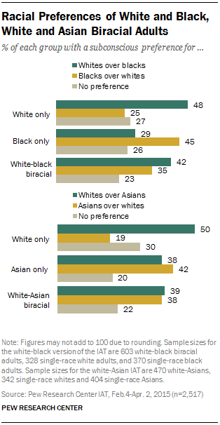
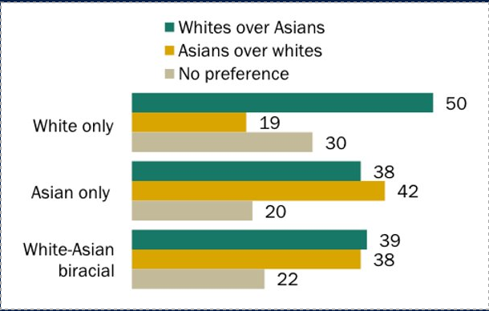
Racial Preferences of White/Black/Biracial Adults
Notes:
Overall the test found that about three-quarters of respondents in each of the five racial groups, including those who are biracial, demonstrated some degree of implicit racial bias. Across the groups, only about 20% to 30% of those in the study were found to have little or no bias toward the races they were tested against. (Note: Because the pool of adults from which these samples were drawn is not representative of the adult population, the results of this study should be viewed as exploratory.​
The study found wide variation in racial preferences within each of the five test groups. For example, while pluralities of whites and blacks were biased in favor of their own racial group, the same was not true among single-race Asians, who were more evenly divided in their subconscious preferences.

Slide 15
Bias versus Unconscious Bias
Bias
  A strong inclination of the mind or a preconceived opinion about someone or something
Unconscious Bias
  “the attitudes or stereotypes that affect our understanding, actions, and decisions in an unconscious manner. These biases, which encompass both favorable and unfavorable assessments, are activated involuntarily and without an individual’s awareness or intentional control.”
(Blair, 2002; Rudman, 2004; Staats, 2014)

Slide 16
Implicit Bias: Unconscious Bias
Examples
  Resumes with ethnic sounding names pushed down in the selection for interviews (Bertrand & Mullainathan, 2004)
  Science faculty rated male applicants for a laboratory manager position as significantly more competent and hirable than female applicants. Faculty also selected a higher starting salary and offered more career mentoring to the male applicant (Moss-Racusin et al, 2012).

Slide 17
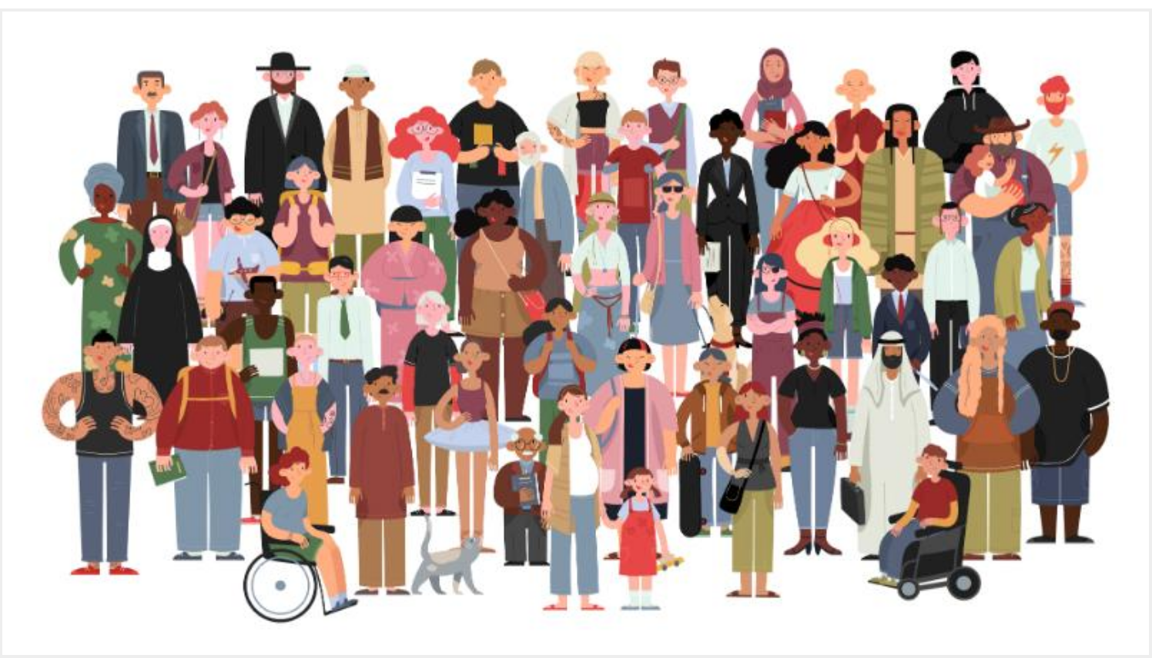
How diverse is your universe?
trainingjournal.com
Notes:
The How Diverse is Your Universe? activity is integral to helping participants reflect on who they actually spend time with and, perhaps even more importantly, who they chose to spend time with. This activity has been shown to increase students’ current exposure to ethnoracial diversity.³⁹ The questions used (Categorize the following into same vs different ethnicity: the last person you went out with socially, your last dinner guest was, etc.) were actually conducted in the large group first, with visual representations of the whole group’s responses anonymously hosted on PollEV in real-time. Next, debrief questions were asked in small groups, engaging the participants in reflections on the impact of the visual representations of their answers and the reality of the extent of diversity in their social circles.

Slide 18
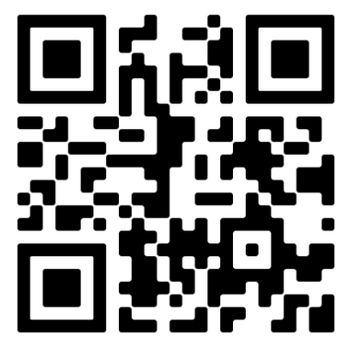
Go to PollEV.com link
https://pollev.com/odinakachukw765

Slide 19
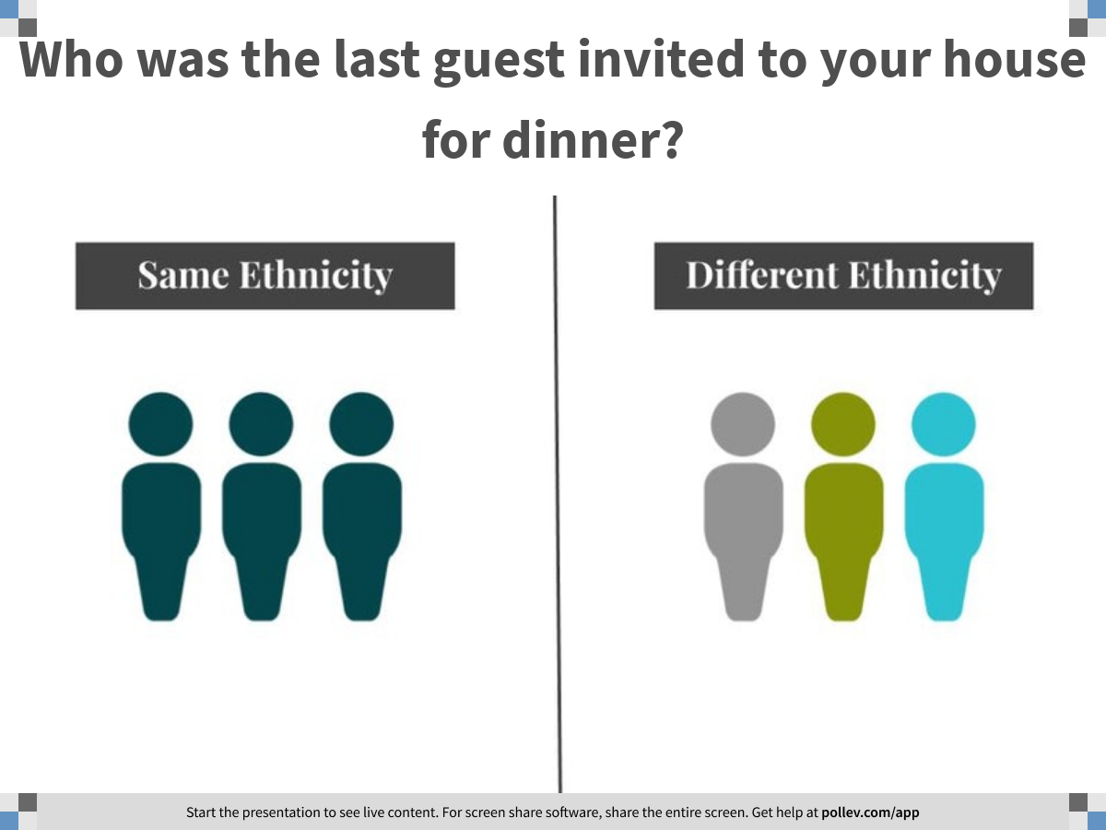
Notes:
Who was the last guest invited to your house for dinner?
https://www.polleverywhere.com/clickable_images/fxZir0DjzarmrCs8rWSzv

Slide 20
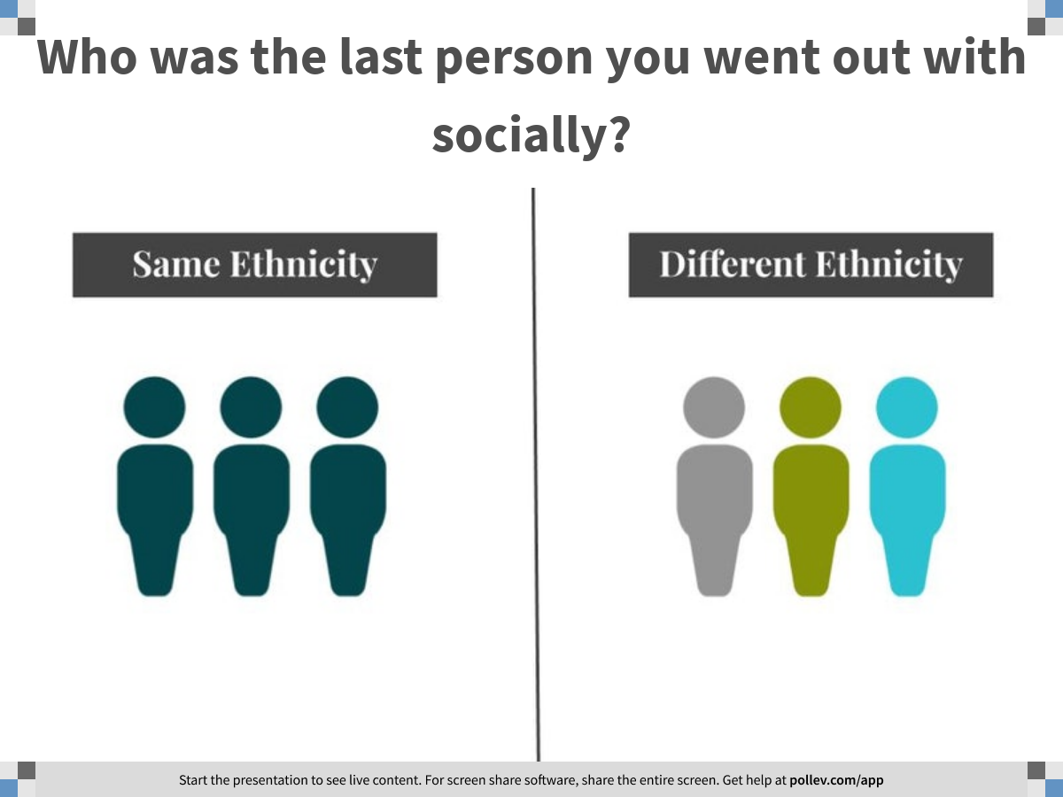
Notes:
Who was the last person you went out with socially?
https://www.polleverywhere.com/clickable_images/2xGhR0JGQYzE7viGblpf6

Slide 21
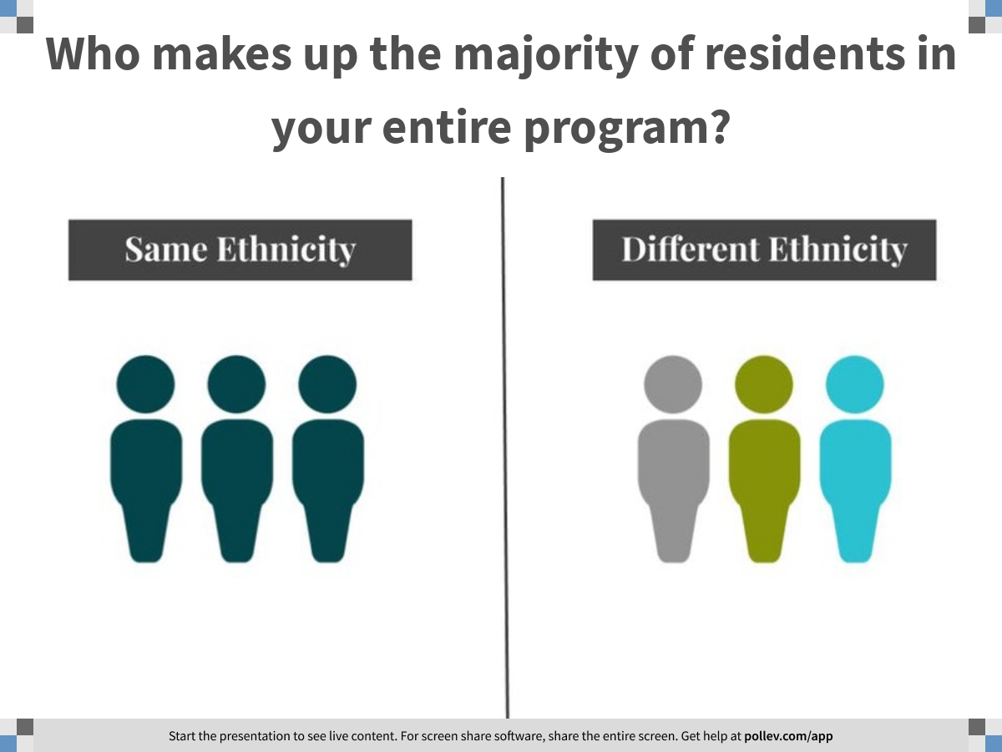
Notes:
Who makes up the majority of residents in your entire program?
https://www.polleverywhere.com/clickable_images/iEO6FkZvFtcyWyZhn9fzT

Slide 22
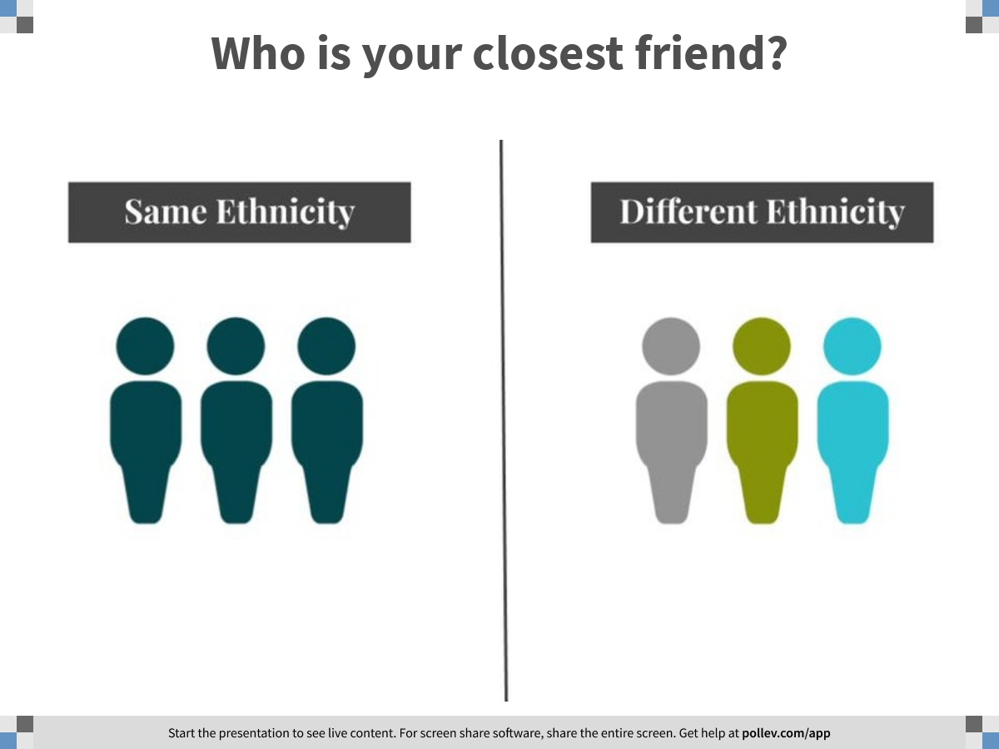
Notes:
Who is your closest friend?
https://www.polleverywhere.com/clickable_images/ZP2j7vxR0SD2KXBII7SUI

Slide 23
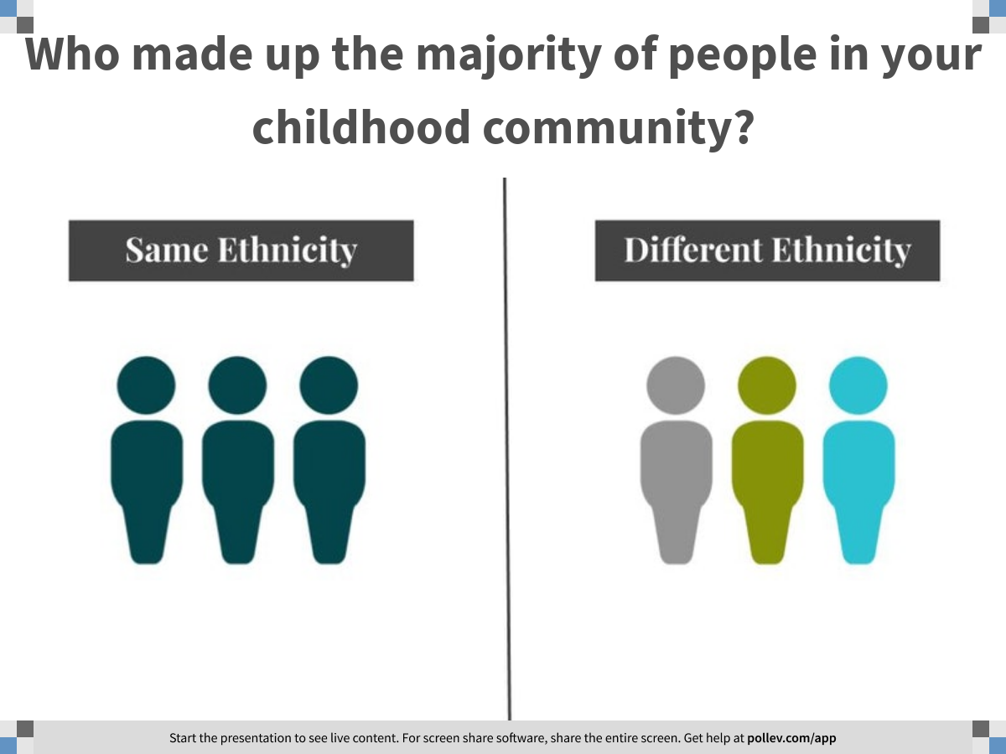
Notes:
Who made up the majority of people in your childhood community?
https://www.polleverywhere.com/clickable_images/YiDxU5WCaDkRpwY1SoUqG

Slide 24
Stereotype
Stereotype
  The conceptual attributes linked to a particular group as defined by a culture
  Involves the encoding and storage of “stereotype” concepts, their selection and activation into working memory and their application in judgments and behaviors
Stereotype suppression
  Active suppression of stereotypical thoughts about an individual of a different background that usually results in decreased social encounters

Slide 25
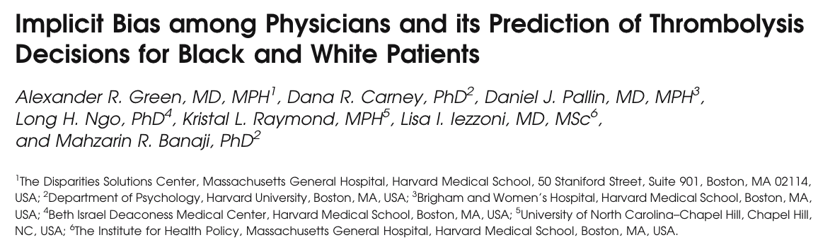
Study to test whether physicians show implicit race bias and whether this bias predicted clinical decisions regarding thrombolysis recommendations with ACS patients.
Main outcome measures:
  IAT scores measuring physicians’ implicit race preference
  Perception of cooperativeness
  Physicians’ attribution of symptoms to coronary artery disease for vignette patients with randomly assigned race
  Physicians’ decision about thrombolysis
  Assessment of physicians’ explicit racial biases by questionnaire
Notes:
An internet-based tool comprising a clinical vignette of a patient presenting to the emergency department with an acute coronary syndrome, followed by a questionnaire and three Implicit Association Tests (IATs). Study invitations were e-mailed to all internal medicine and emergency medicine residents at four academic medical centers in Atlanta and Boston; 287 completed the study, met inclusion criteria, and were randomized to either a black or white vignette patient.

Slide 26
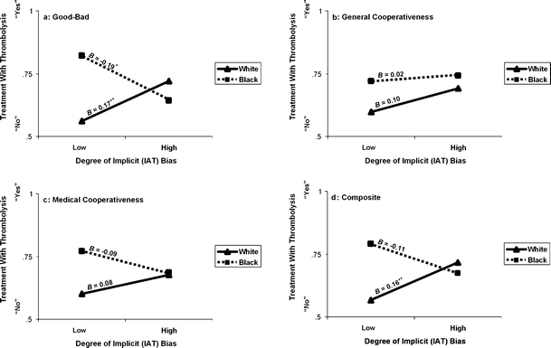
Does our bias predict behaviors?
Physicians reported no explicit racial preference
IAT demonstrated implicit preference favoring white Americans (p<0.001) and implicit stereotypes of black = less cooperative
Correlation of pro-white implicit bias with likelihood of treating white and not black patients with thrombolysis
Green et al., 2007
Notes:
Physicians reported no explicit preference for white versus black patients or differences in perceived cooperativeness. In contrast, the IATs revealed implicit preference favoring white Americans (mean IAT score=0.36,P<.001, one-sample t test) and implicit stereotypes of black Americans as less cooperative with medical procedures (mean IAT score 0.22,P<.001), and less cooperative generally (mean IAT score 0.30,P<.001). As physicians’ prowhite implicit bias increased, so did their likelihood of treating white patients and not treating black patients with thrombolysis (P=.009).
Results suggest that physicians’ unconscious biases may contribute to racial/ethnic disparities in use of medical procedures such as thrombolysis for myocardial infarction.
Furthermore, This correlation reminds us that implicit biases may affect the behavior even of those individuals who have nothing but the best intentions, including physicians
Also, those physicians who were aware that the study had to do with racial bias, and who had higher levels of implicit prowhite bias, were more likely to recommend thrombolysis to black patients than physicians with low bias—the opposite of the study’s main effect. This suggests that implicit bias can be recognized and modulated to counteract its effect on treatment decisions. These finding support the IAT’s value as an educational tool .There are several limitations inherent in this study. Response rates were relatively low and the sample size smaller than ideal, making it difficult to detect smaller effects that may exist. Resident physicians, particularly those at large academic health centers in Boston and Atlanta

Slide 27
Wrap Up
In one word, one thing you are walking away from this workshop?
      Insert PollEV link for wordcloud
Notes:
https://PollEv.com/free_text_polls/GoxSaH834LAeEoNxq35um/respond

Slide 28
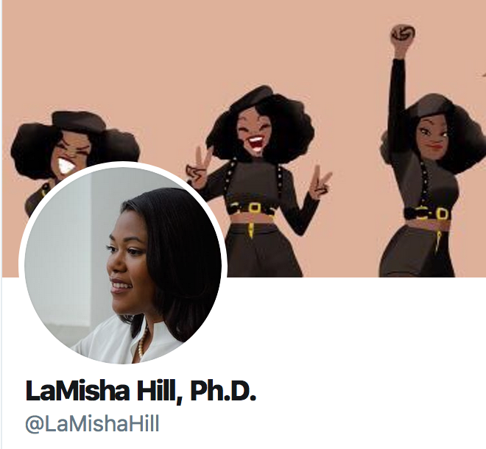
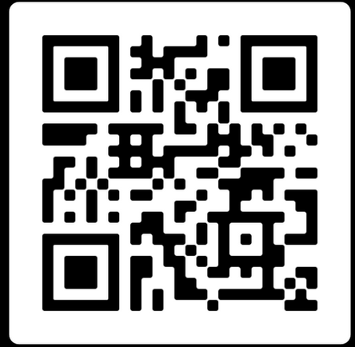
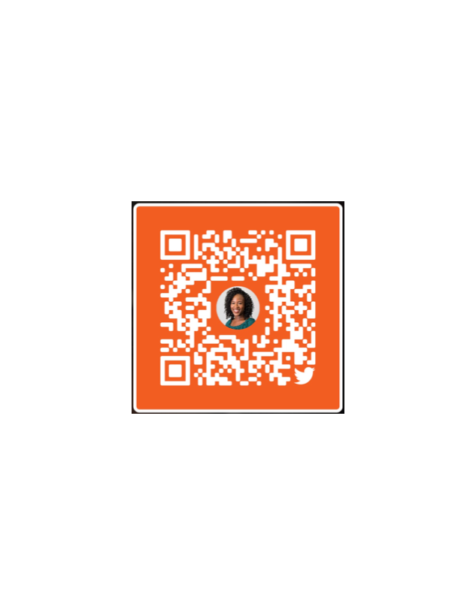
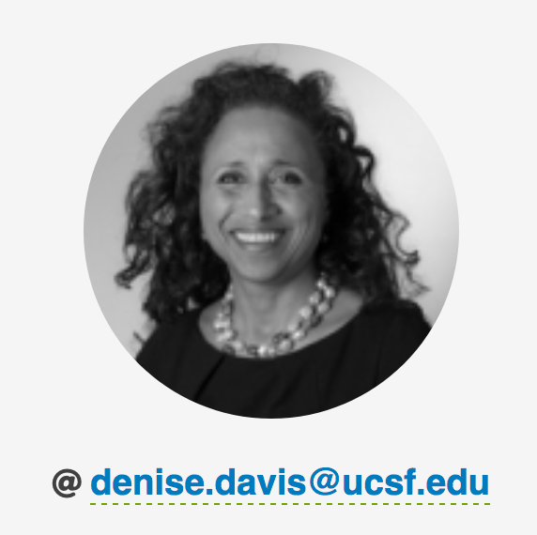
Thank You
References
@OdinakachukwuE5

