Slide 1
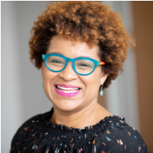
Fireside Chat with Leah Pimentel
DEI & How Belonging Transforms
Leah Pimentel, MBA
Director of DEI & Culture

Slide 2
Welcome
Webinar Logistics
Closed Captioning: To access closed captioning, click the CC button. Select “View Full Transcript” for information about who is speaking.
Troubleshooting: If you need technical assistance, please indicate that in the Q&A so we can help.
Webinar Recording: To request the recording of today’s webinar, please contact sheara.cohen@ucsf.edu.
Notes:
Closed Captioning: Welcome to our program. We have enabled closed captioning. To access closed captioning, click the CC button at the bottom of your screen, and select “View Full Transcript” for information about who is speaking.
Troublshooting Technical Difficulties: If you have technical difficulties, please…………………………………………………
Recording: Please be aware that this webinar is being recorded today. If you’d like to receive a link to the recording for viewing at another time, please contact sheara.cohen@ucsf.edu.

Slide 3
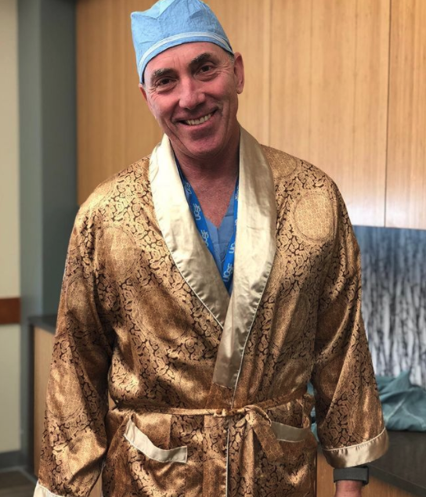
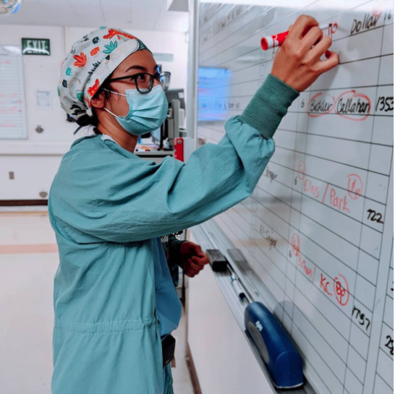
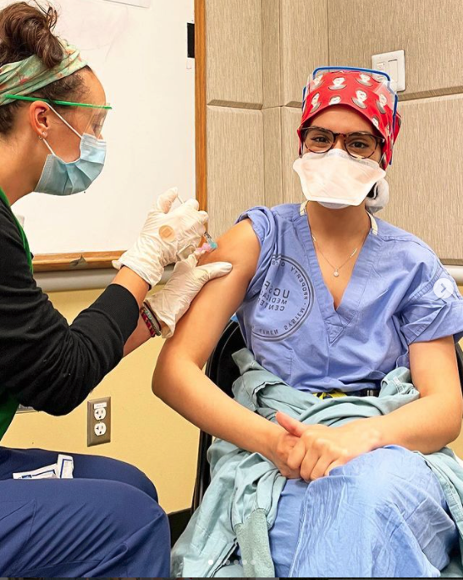
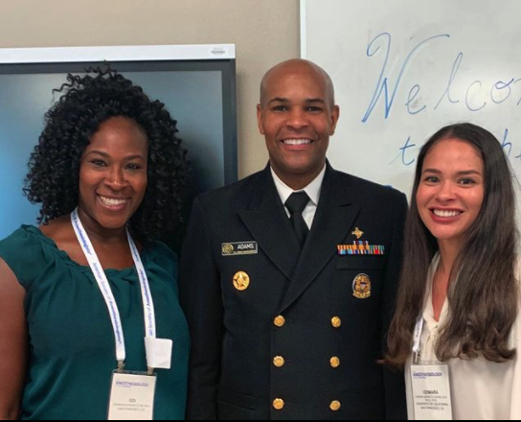

Slide 4
Leah Pimentel, MBA
Department of Anesthesia’s Inaugural Director of DEI & Culture

Slide 5
A Message from the Director of DEI & Culture

Slide 6
This Strategic Plan includes:
A compelling DEI vision, plan, and business case developed and communicated internally and externally and embedded in all department policies and procedures.
Development of DEI goals and milestones with leadership and staff being held accountable for a commitment to advancing DEI and culture in the department and having all staff, faculty, fellows, residents, fellows, and interns see themselves as leaders in this work.
Notes:
We are all on a journey, and the DEI & Strategic place is a guide for that journey that includes a vision and a plan.

Slide 7
A culture where diverse perspectives are engaged and valued across the department, relationships are valued, and there is a culture of respectful transparency and feedback.
A commitment to accessible and equitable recruitment, retention, advancement, and reflection of the diversity of the labor market at all levels of the department.
Notes:
We value diverse cultures and are committee to equitable recruitment, retention and advancement at all levels of the department.

Slide 8
An atmosphere of inclusion leveraging the creativity and connection diversity can bring to drive innovation and uphold exceptional levels of service.
The advancement of DEI internally and externally by utilizing community partners empowering historically underserved communities to be drivers of equity within their own communities.
Notes:
To learn about diverse cultures we have began engaging with the community and cultural districts as speaking to learn about tehir experiences, work and contributions

Slide 9
Diversity, Equity, Inclusion, & Culture Statement

Slide 10
The department of Anesthesia and Perioperative Care brings people from diverse backgrounds to become one of the preeminent Departments in the world. We are passionate about well-being for our staff, faculty, residents, fellows, and interns.

Slide 11
We are committed to building and sustaining a culture of belonging that reflects all people; and where members of every age, race, national origin, gender identity, sexual orientation, ability, and religion feel welcome, seen, heard, and supported. Diversity develops better collaborators, stronger communicators, greater innovators, and deeper thinkers.

Slide 12
Creating a diverse, equitable, and inclusive department is an ever-evolving journey. We challenge ourselves to do this work on a personal and institutional level, with empathy and mutual respect. Building and sustaining a diverse, equitable, and inclusive department is the responsibility of all. We are committed to diversity, equity, and inclusion, and hold the promise of a better future for all.

Slide 13
What is Diversity, Equity, and Inclusion (DEI)?

Slide 14
Diversity
Focuses on increasing the representation of protected classes, the groups that have historically been disadvantaged: minorities, individuals with disabilities, women, veterans, and the LGBTQ+ population. Beyond that, the definition can also include all dimensions that make us different, which may include diversity of economic backgrounds, education, perspective, and political thought.
Broadening the term helps to bring together a mix of perspectives, enables people to bring into that discussion their unique backgrounds and experiences, and have a very spirited discussion. It is then and only then, that you allow for the superior ideas to emerge. And that’s how you achieve better outcomes. That’s how you become a better organization.
Notes:
Focusing on the under represent and brining them and their unquie background in the mix of things to achive better outcomes leading to a better organization.

Slide 15
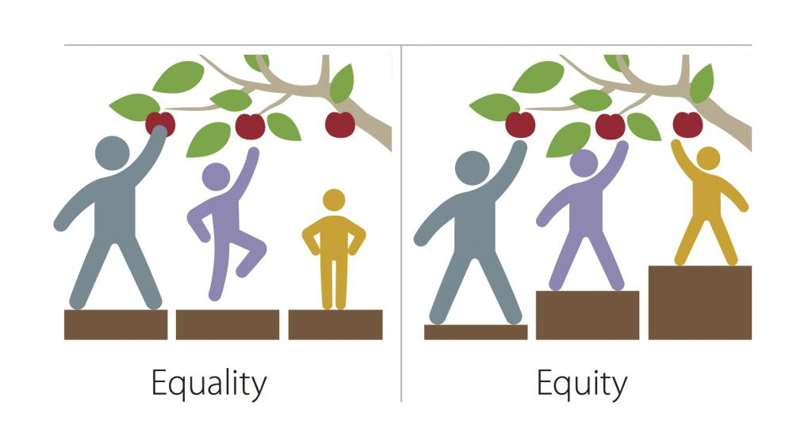
Equity
Focuses on treating everyone fairly, providing equal access to opportunities within your organization, equal pay for equal work, and committing ourselves to removing any barriers that may prevent that.
Notes:
Everyone wants to be treated fairly and we can by eliminating barriers

Slide 16
Inclusion
Unleashes the power of diversity.
Diversity without inclusion is like being invited to the party but not being asked to dance. We can’t have diversity without inclusion; otherwise, we will continue to bring in diverse employees only to lose them through the back door, because they don’t see a future with the organization.
To be able to grow diverse teams and harness the power of diversity, we need to build a culture where people feel a strong sense of belonging, where employees from all groups and backgrounds are accepted, respected, valued; where they can bring their full selves to work; and in the process contribute their best work.
Notes:
We are building a community where people feel they belong. No wants to be intvited to the party but not asked to dance.

Slide 17
DEI is:
A transformation process with all dimensions of difference
Comprehensive and requires an integrated approach permeating the entire organization
Made up of multiple departments and components
Based on organizational diagnostic assessment
Aligned with core values
Effective communication throughout the organization
Securing leadership support and buy-in including an executive sponsor and a designated senior executive to lead efforts
Notes:
Transformational process with many componets; everyone including leadership needs to buy-in

Slide 18
DEI is not:
Only about race or gender
A onetime project
Just a compliance-based numbers focus
A short-term need for incremental change
Notes:
It’s not one group or one progress it’s continual

Slide 19
Vision Statement

Slide 20
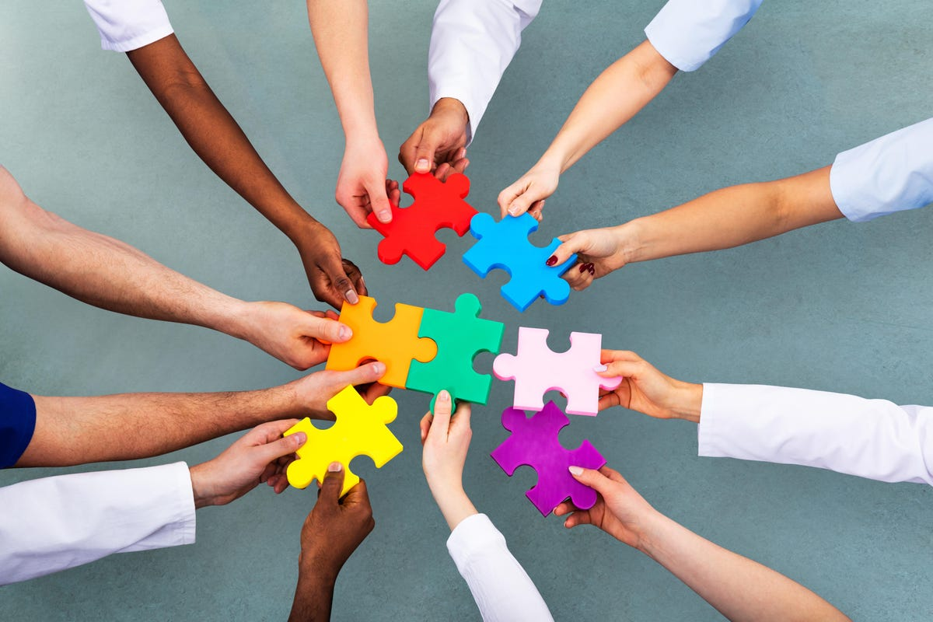
Areas of Impact
Leadership
Talent Management
Inclusive Culture
Social Responsibility
Brand & Patient Care
Vendor Diversity
Measurement & Accountability

Slide 21
Alignment and Continued Leadership
Goals & Metrics
Leadership Engagement and Policies:
Leadership demonstrates commitment to supporting innovation and progress with respective departments
100% leadership participation in DEI related programming, workshops, and events.
Further DEI Expansion and Alignment across Organization:
Use DEI to continue being more intentional in advancing department brand and align with DEI goals
Notes:
It’s just not me, it’s all of us that have to be committee to DEI & Culture to move forward innovation.

Slide 22
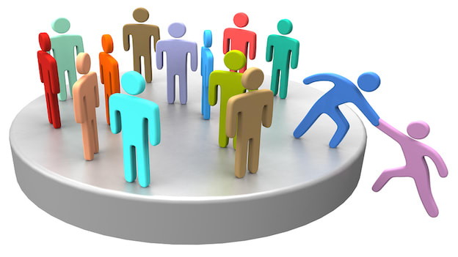
Advancing Organizational Talent Diversity
Goals & Metrics
Talent Acquisition & Recruitment
Onboarding
Retention
Notes:
Where we reach impacts who we reach.
We want new hires to get a sense of our brand and why they are here during on-boarding
How do we keep you? Little bits of consisitancy of why you are here and feeling valued

Slide 23
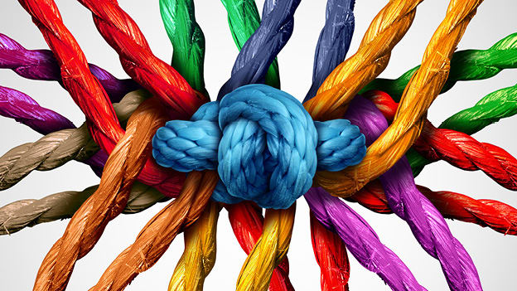
Increase & Continue the Development of Inclusive Internal Culture
Goals & Metrics
Staff DEI Committee
DEI Training & Continued Learning Opportunities
Policy & Strategy Review
Personnel & Stakeholders
Notes:
Streamline internal policy review and feedback channels.

Slide 24
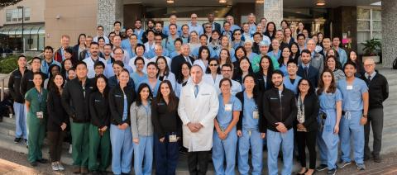
Social Responsibility
Goals & Metrics
Community Engagement
Philanthropic Giving

Slide 25
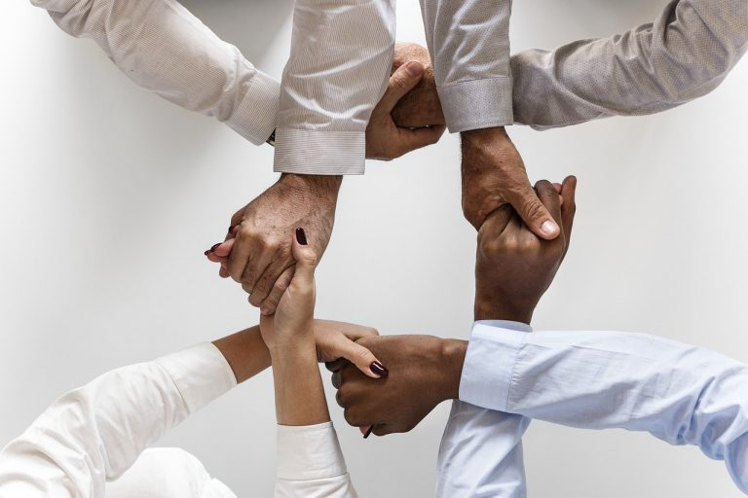
Brand & Patient Care
Goals & Metrics
Partnerships
Marketing & Brand Awareness
Notes:
Expand marketing and brand synergy to provide sense of department culture and advancements in patient care.
Buildout and expand information and highlights on current DEI page of website
Increase DEI related partnerships with current and future partners.

Slide 26
Vendor Diversity
Goals & Metrics
Majority use of diverse vendors for purchasing
Diverse vendor reach expanded to provide more opportunities for suppliers
Develop intentional strategies to track and uphold vendor commitment to supplier-chain and partnership diversity.
By year 2, track vendor diversity

Slide 27
Inclusion Groups
Anesthesia and Perioperative Care Diversity, Equity, and Inclusion Advisory Committee strives to address, explore, educate, learn about, and respond to the diversity of the staff experience.
Employee Resource Groups where team members gather to share common interests, backgrounds, or demographics.
Notes:
Adding affinity group and rebranding the advisory

Slide 28
Building Community & Exploring Cultures through Food
Assemble a Department of Anesthesia and Perioperative Care staff cookbook so staff members can learn about each other, their cultures, and their favorite cultural dishes.
Create a quarterly international food festival where attendees receive an “International Food Fest Passport,” enabling them to sample food from many different countries.
This Photo by Unknown Author is licensed under CC BY-NC-ND

Slide 29
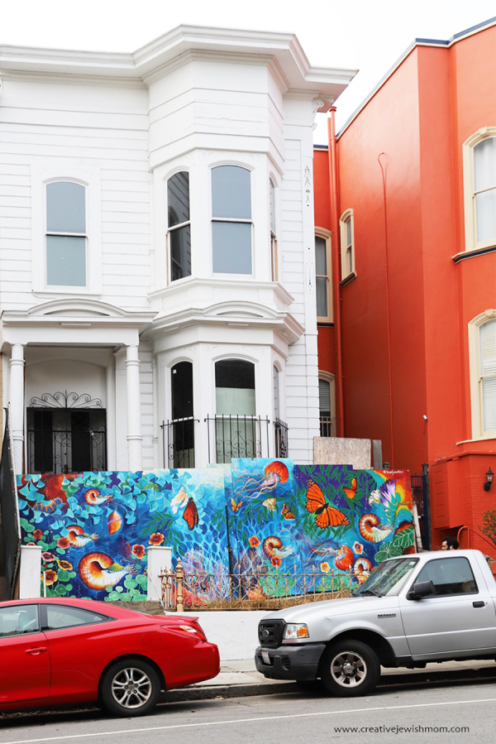
UCSF Art Walk
Leaders from UCSF and the arts communities will partner to create a UCSF Art Walk.
Celebrate the art, music, food, and small businesses of the city with artists from different SF neighborhoods.

Slide 30
DEI Report Showcase
Host an external Diversity, Equity, & Inclusion (DEI) panel discussion with DEI leaders (Warriors, 49ers, SF District Attorney’s Office, and Recology) as part of a larger effort to promote the understanding of DEI and accomplishments. Panelists will provide their thoughts on many aspects of DEI and will answer questions from the moderators and audience.
Host internal UCSF Diversity, Equity, & Inclusion (DEI) panel discussion with DEI leaders from ODO, Department of Psychiatry and Behavioral Sciences, Alumni Relations, and the Memory and Aging Center to highlight trailblazing efforts and generate a rich discussion on issue that will promote a better understanding of the benefits, issues, and challenges and will energize audience members to take steps to promote DEI in the workplace.

Slide 31
Accessibility
We are in a unique position when it comes to incorporating accessibility into DEI efforts.

Slide 32
DEI Projects Approval Process

Slide 33
Work-Life-Balance Campaign

Slide 34
Work Life Balance Campaign
How, when, and where we work is evolving
The workday is no longer the stereotypical 9-5
The concept of flexible work hours is common and accepted
We have increasing virtual/online interaction
Many of us have been working remotely for the last 2+ years

Slide 35
Sample Email Signatures
Incorporate a signature to convey expectations!
Consider using one of the following statements in your email signature to let others within our department, the greater UCSF community, and outside the University know you understand and respect their work/life balance and acknowledge that everyone has a different workday:
My workday may look different from your workday. Please do not feel obligated to respond outside of your typical working hours.
Please note I do not expect a response to my emails on nights, weekends, or holidays.
I do not respond to emails on weekends. If this is an emergency, please <<insert directions of who to contact>>.
I work flexibly and may send emails outside traditional office hours. No need to respond to my emails outside yours.

Slide 36
One City One Book

Slide 37
When we listen and celebrate what is both common and different, we become wiser, more inclusive, and better as an organization.
Pat Wadors
Notes:
I’d like to close eith a quote

Slide 38
Thank you.
Leah Pimentel, MBA
Director of DEI & Culture
Leah.Pimentel@ucsf.edu

